Slide 1
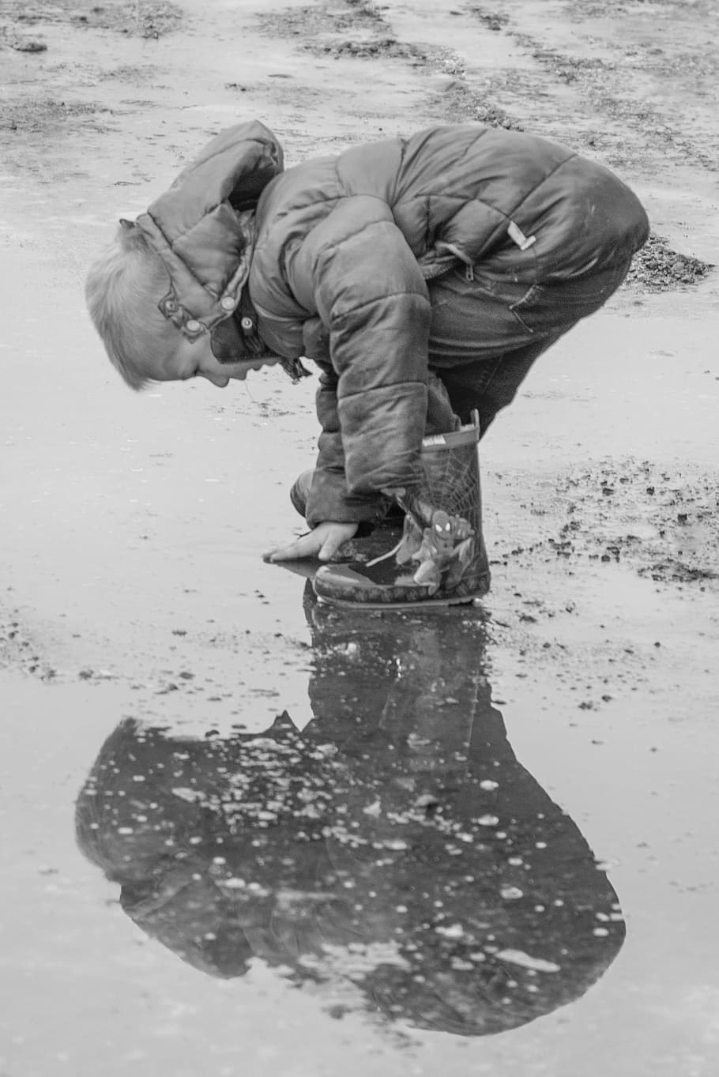
SSIP Work Group:
Reflective Supervision
5/23/2023

Slide 2
Feb. 28 2023
Mar. 25 2023
April 25 th
Initial Gathering of the work group.
Shared the Goals/tasks of the work group.
Defined Reflective Supervision and Consultation
Discussed the need for Reflective Supervision in Part C Services .
Reviewed/Discussed the Briefing Paper(ZZT) on the Integration of IECMH and Early Intervention.
Identified What Reflective Supervision and Consultation looks like in systemic practice.
Group discussion: difference between Individual and group Reflective Supervision
How Reflective Supervision can support team Retention, Reduce team burnout, creation of alliances between Supervisory staff and direct providers.

Slide 3
May 23, 2023
June 27, 2023
July 25, 2023
Judith Martens, LCSW, IMH-E, IMHM-C presented to the group on “Our Way of Being” in Reflective Supervision and the impact on systems change.
Compile Questions for Early Intervention Interviews
Lorelei Pisha and Tracy Walters will conduct Interviews with North Carolina, Tennessee, and New Mexico’s Early Intervention System to gain Structural Insight, Frameworks, etc.
Report out to the group
Q & A
Discussion
Drafting the Framework for Reflective Supervision in Early Intervention for Virginia
Recommendations Including:
Resource Mapping
Budget Considerations
Time/Scheduling Considerations
Review/Tweak Executive Summary

Slide 4
Aug. 22, 2023
Sept. 26, 2023
Oct. 24, 2023
Review the Executive Summary
Prepare for presentation
Virtual Meeting with Kyla Patterson, 12-1 p.m./Scheduled
Presentation of our scope of Work and recommendations for Reflective Supervision in Early Intervention Services.
If additional time/resources are requested a work hour to refine.

Slide 5
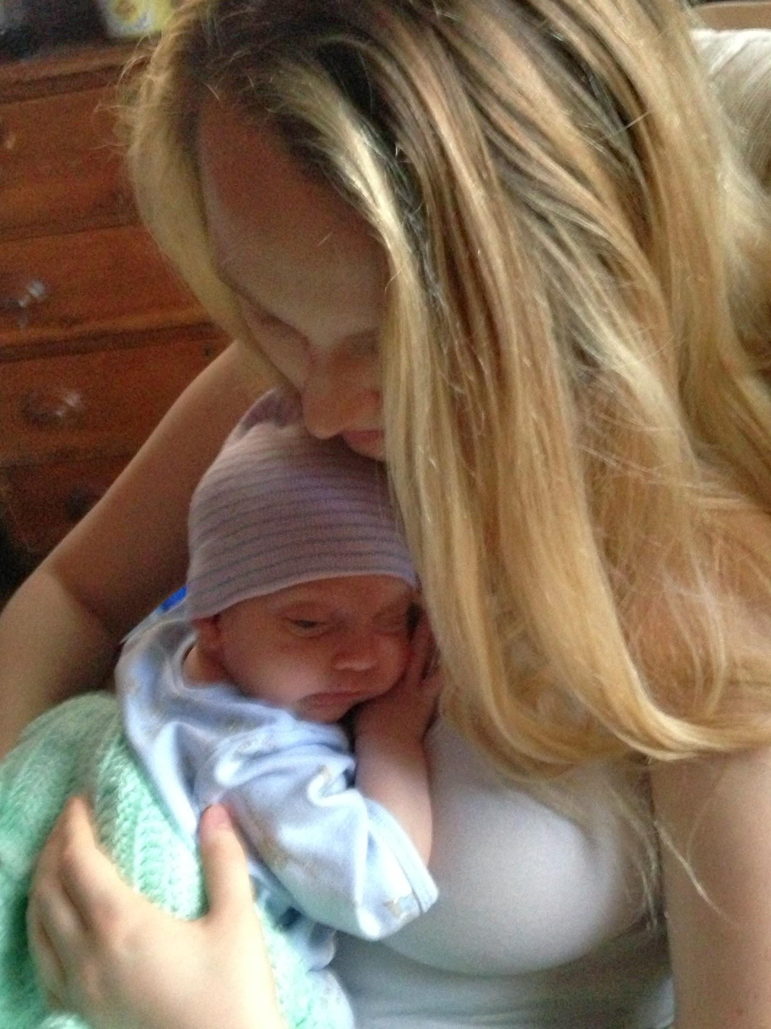
“Our Way Of Being”
Frameworks for Reflective Supervision

Slide 6
Reflective Supervision In Virginia
Reflective Supervision

Slide 7
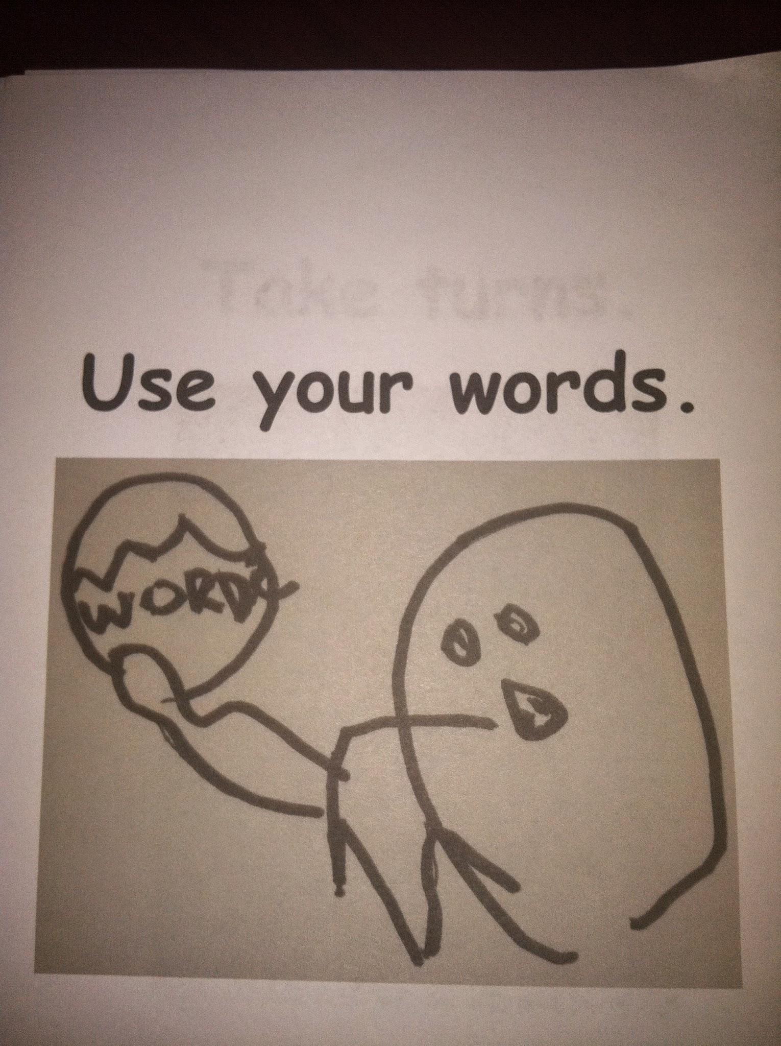
Generating Questions for Early Intervention Interview…

Slide 8
Lorelei Wrap-up

